Slide 1
gdp fORECASTING
By: Madiha Najam, Fatima Zahra El Mansouri, Tanvir, Shehryar Siddiqui
https://github.com/siddi582/PfizerFinalProject-

Slide 2
Canadas wALKTHROUGH
Literacy Adult
Literacy Youth
Health Expenditures
Life Expectancy

Slide 3

ExPloring the dataset
Tools used:
Excel
Tableau
Machine-Learning
ETL
Linear Regression

Slide 4

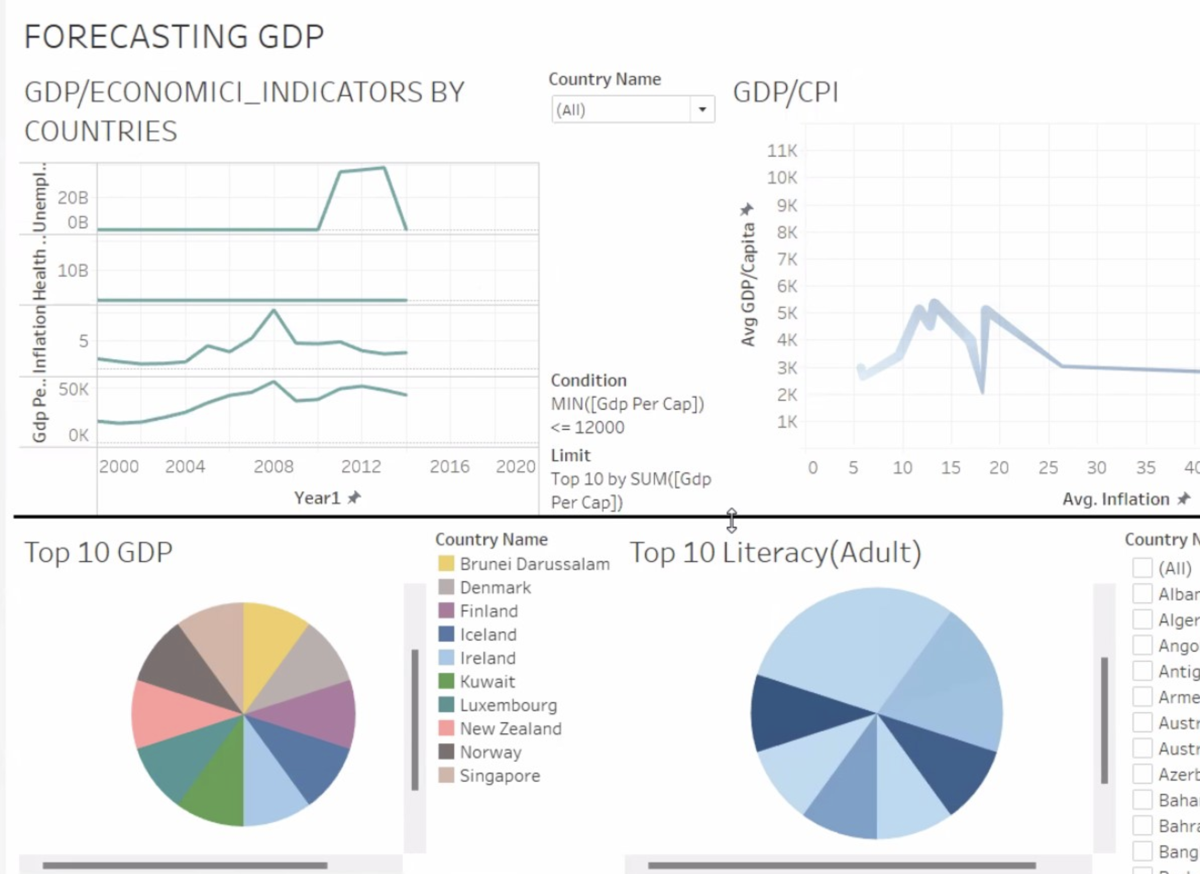
GDP FOReCast
Canada consumes x amount of fossil fuels and x amount of energy , most of the people live in urban areas
More Investments can be made through:
Population Density
Canadian Agriculture
Energy Production
We can assume that that their will be growth in the future in such areas

Slide 5
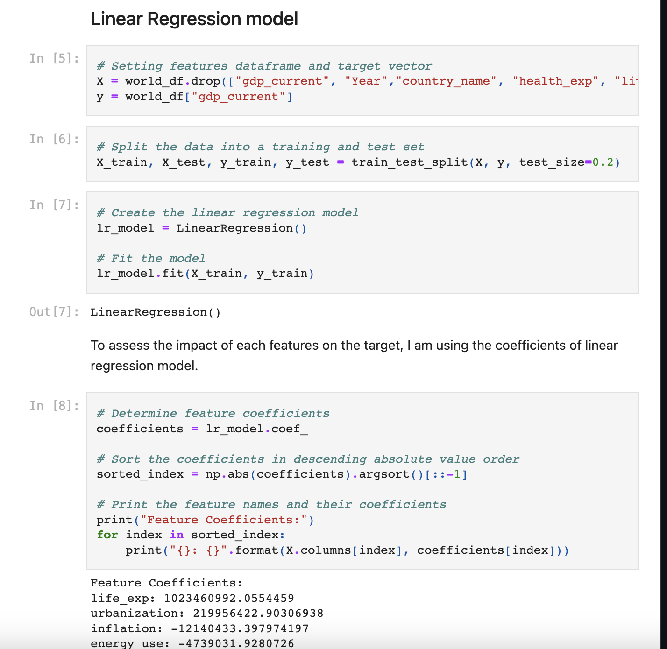
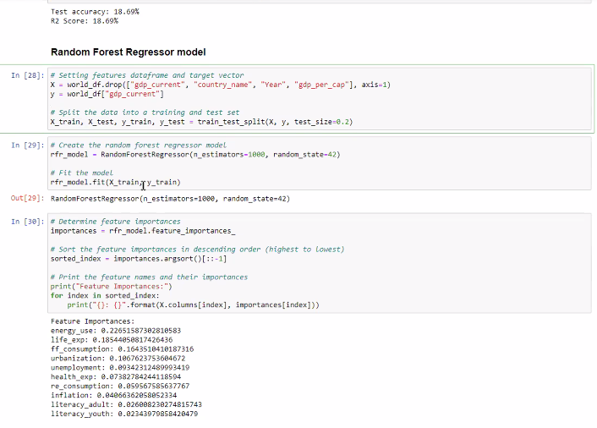
Best MODEL: Linear Regression

Slide 6
ACCURACY TRACKING METHOD

Slide 7
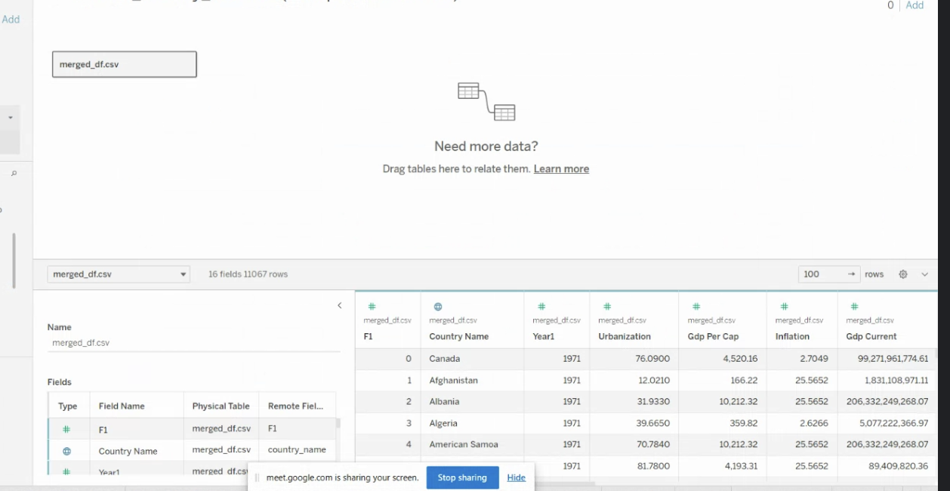
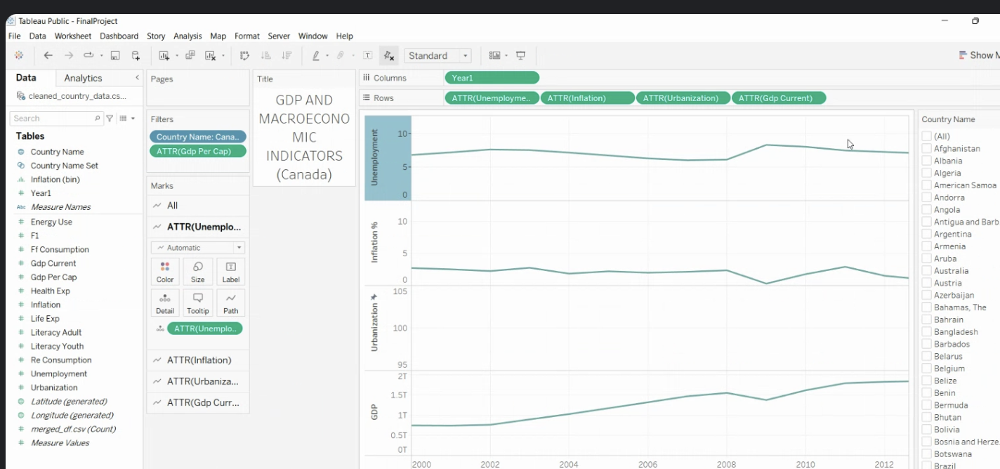
Values
If someone wants to predict GDP, we drop GDP current and country name
They must provide economic indicators

Slide 8
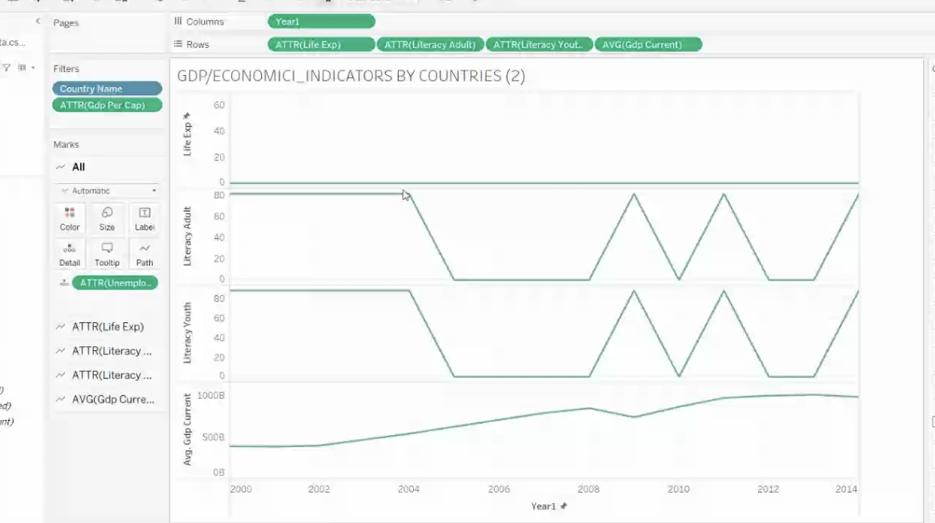
conclusion

Slide 9
Questions?

